Slide 1
Lecture 03:
Computer Networks and the Internet (3/3)
Protocol Layers and Delay, loss and throughput in packet-switched networks
CSIM603154 - Jaringan Komunikasi Data
Fakultas Ilmu Komputer UI

Slide 2
Protocol “layers”
Networks are complex,
with many “pieces”:
  hosts
  routers
  links of various media
  applications
  protocols
  hardware, software
Question:
is there any hope of organizing structure of network?
…. or at least our discussion of networks?
Introduction
1-<number>

Slide 3
Organization of air travel
ticket (purchase)
baggage (check)
gates (load)
runway takeoff
airplane routing
ticket (complain)
baggage (claim)
gates (unload)
runway landing
airplane routing
airplane routing
a series of steps
Introduction
1-<number>

Slide 4

Layering of airline functionality
ticket (purchase)
baggage (check)
gates (load)
runway (takeoff)
airplane routing
ticket (complain)
baggage (claim
gates (unload)
runway (land)
airplane routing
ticket
baggage
gate
takeoff/landing
airplane routing
airplane routing
airplane routing
departure
airport
intermediate air-traffic
control centers
arrival
airport
layers: each layer implements a service
  via its own internal-layer actions
  relying on services provided by layer below
Introduction
1-<number>

Slide 5
Why layering?
dealing with complex systems:
explicit structure allows identification, relationship of complex system’s pieces
  layered reference model for discussion
modularization eases maintenance, updating of system
  change of implementation of layer’s service transparent to rest of system
  e.g., change in gate procedure doesn’t affect rest of system
layering considered harmful?
Introduction
1-<number>

Slide 6
Internet protocol stack
application: supporting network applications
  FTP, SMTP, HTTP
transport: process-process data transfer
  TCP, UDP
network: routing of datagrams from source to destination
  IP, routing protocols
link: data transfer between neighboring network elements
  Ethernet, 802.111 (WiFi), PPP
physical: bits “on the wire”
application
transport
network
link
physical
Introduction
1-<number>

Slide 7
ISO/OSI reference model
presentation: allow applications to interpret meaning of data, e.g., encryption, compression, machine-specific conventions
session: synchronization, checkpointing, recovery of data exchange
Internet stack “missing” these layers!
  these services, if needed, must be implemented in application
  needed?
application
presentation
session
transport
network
link
physical
Introduction
1-<number>

Slide 8

Encapsulation
source
message
M
application
transport
network
link
physical
segment
H_{t}
M
H_{t}
datagram
H_{n}
H_{n}
H_{t}
M
frame
H_{l}
H_{n}
H_{t}
M
link
physical
switch
destination
H_{n}
H_{t}
M
network
link
physical
M
application
transport
network
link
physical
H_{l}
H_{n}
H_{t}
M
H_{n}
H_{t}
M
H_{t}
M
H_{n}
H_{t}
M
H_{l}
H_{n}
H_{t}
M
router
Introduction
1-<number>

Slide 9
How do loss and delay occur?
packets queue in router buffers
packet arrival rate to link (temporarily) exceeds output link capacity
packets queue, wait for turn
packet being transmitted (delay)
A
B
packets queueing (delay)
free (available) buffers: arriving packets
dropped (loss) if no free buffers
Introduction
1-<number>

Slide 10
Four sources of packet delay
transmission
A
propagation
B
nodal
processing
queueing
d_{nodal} = d_{proc} + d_{queue} + d_{trans} + d_{prop}
d_{proc}: nodal processing
check bit errors
determine output link
typically < msec
d_{queue}: queueing delay
time waiting at output link for transmission
depends on congestion level of router
Introduction
1-<number>

Slide 11
Four sources of packet delay
transmission
A
propagation
B
nodal
processing
queueing
d_{nodal} = d_{proc} + d_{queue} + d_{trans} + d_{prop}
d_{trans}: transmission delay:
L: packet length (bits)
R: link bandwidth (bps)
d_{trans} = L/R
d_{prop}: propagation delay:
d: length of physical link
s: propagation speed in medium (~2x10⁸ m/sec)
d_{prop} = d/s
d_{trans} and d_{prop}
very different
* Check out the Java applet for an interactive animation on trans vs. prop delay
Introduction
1-<number>

Slide 12
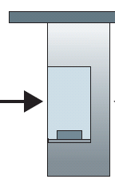

Caravan analogy
100 km
100 km
ten-car
caravan
toll
booth
toll
booth
cars “propagate” at
100 km/hr
toll booth takes 12 sec to service car (bit transmission time)
car~bit; caravan ~ packet
Q: How long until caravan is lined up before 2nd toll booth?
time to “push” entire caravan through toll booth onto highway = 12*10 = 120 sec
time for last car to propagate from 1st to 2nd toll both: 100km/(100km/hr)= 1 hr
A: 62 minutes
Introduction
1-<number>

Slide 13
Caravan analogy (more)
100 km
100 km
ten-car
caravan
toll
booth
toll
booth
suppose cars now “propagate” at 1000 km/hr
and suppose toll booth now takes one min to service a car
Q: Will cars arrive to 2nd booth before all cars serviced at first booth?
A: Yes! after 7 min, 1st car arrives at second booth; three cars still at 1st booth.
Introduction
1-<number>

Slide 14


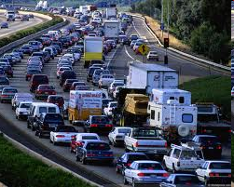
Queueing delay (revisited)
R: link bandwidth (bps)
L: packet length (bits)
a: average packet arrival rate
average queueing delay
traffic intensity
= La/R
La/R ~ 0: avg. queueing delay small
La/R -> 1: avg. queueing delay large
La/R > 1: more “work” arriving
than can be serviced, average delay infinite!
La/R ~ 0
* Check out the Java applet for an interactive animation on queuing and loss
La/R -> 1
Introduction
1-<number>

Slide 15
“Real” Internet delays and routes
what do “real” Internet delay & loss look like?
traceroute program: provides delay measurement from source to router along end-end Internet path towards destination. For all i:
  sends three packets that will reach router i on path towards destination
  router i will return packets to sender
  sender times interval between transmission and reply.
3 probes
3 probes
3 probes
Introduction
1-<number>

Slide 16
“Real” Internet delays, routes
traceroute: gaia.cs.umass.edu to www.eurecom.fr
3 delay measurements from
gaia.cs.umass.edu to cs-gw.cs.umass.edu
1 cs-gw (128.119.240.254) 1 ms 1 ms 2 ms
2 border1-rt-fa5-1-0.gw.umass.edu (128.119.3.145) 1 ms 1 ms 2 ms
3 cht-vbns.gw.umass.edu (128.119.3.130) 6 ms 5 ms 5 ms
4 jn1-at1-0-0-19.wor.vbns.net (204.147.132.129) 16 ms 11 ms 13 ms
5 jn1-so7-0-0-0.wae.vbns.net (204.147.136.136) 21 ms 18 ms 18 ms
6 abilene-vbns.abilene.ucaid.edu (198.32.11.9) 22 ms 18 ms 22 ms
7 nycm-wash.abilene.ucaid.edu (198.32.8.46) 22 ms 22 ms 22 ms
8 62.40.103.253 (62.40.103.253) 104 ms 109 ms 106 ms
9 de2-1.de1.de.geant.net (62.40.96.129) 109 ms 102 ms 104 ms
10 de.fr1.fr.geant.net (62.40.96.50) 113 ms 121 ms 114 ms
11 renater-gw.fr1.fr.geant.net (62.40.103.54) 112 ms 114 ms 112 ms
12 nio-n2.cssi.renater.fr (193.51.206.13) 111 ms 114 ms 116 ms
13 nice.cssi.renater.fr (195.220.98.102) 123 ms 125 ms 124 ms
14 r3t2-nice.cssi.renater.fr (195.220.98.110) 126 ms 126 ms 124 ms
15 eurecom-valbonne.r3t2.ft.net (193.48.50.54) 135 ms 128 ms 133 ms
16 194.214.211.25 (194.214.211.25) 126 ms 128 ms 126 ms
17 * * *
18 * * *
19 fantasia.eurecom.fr (193.55.113.142) 132 ms 128 ms 136 ms
trans-oceanic
link
* means no response (probe lost, router not replying)
* Do some traceroutes from exotic countries at www.traceroute.org
Introduction
1-<number>

Slide 17
Packet loss
queue (aka buffer) preceding link in buffer has finite capacity
packet arriving to full queue dropped (aka lost)
lost packet may be retransmitted by previous node, by source end system, or not at all
buffer
(waiting area)
A
packet being transmitted
B
packet arriving to
full buffer is lost
* Check out the Java applet for an interactive animation on queuing and loss
Introduction
1-<number>

Slide 18
Throughput
throughput: rate (bits/time unit) at which bits transferred between sender/receiver
  instantaneous: rate at given point in time
  average: rate over longer period of time
server, with
file of F bits
to send to client
link capacity
R_{s} bits/sec
link capacity
R_{c} bits/sec
server sends bits
(fluid) into pipe
pipe that can carry
fluid at rate
R_{s} bits/sec)
pipe that can carry
fluid at rate
R_{c} bits/sec)
Introduction
1-<number>

Slide 19
Throughput (more)
R_{s} < R_{c} What is average end-to-end throughput?
R_{s} bits/sec
R_{c} bits/sec
R_{s} > R_{c} What is average end-to-end throughput?
R_{s} bits/sec
R_{c} bits/sec
bottleneck link
link on end-to-end path that constrains end-to-end throughput
Introduction
1-<number>

Slide 20
Throughput: Internet scenario
per-connection end-end throughput: min(R_{c},R_{s},R/10)
in practice: R_{c} or R_{s} is often bottleneck
R_{s}
R_{s}
R_{s}
R
R_{c}
R_{c}
R_{c}
10 connections (fairly) share backbone bottleneck link R bits/sec
Introduction
1-<number>

Slide 21
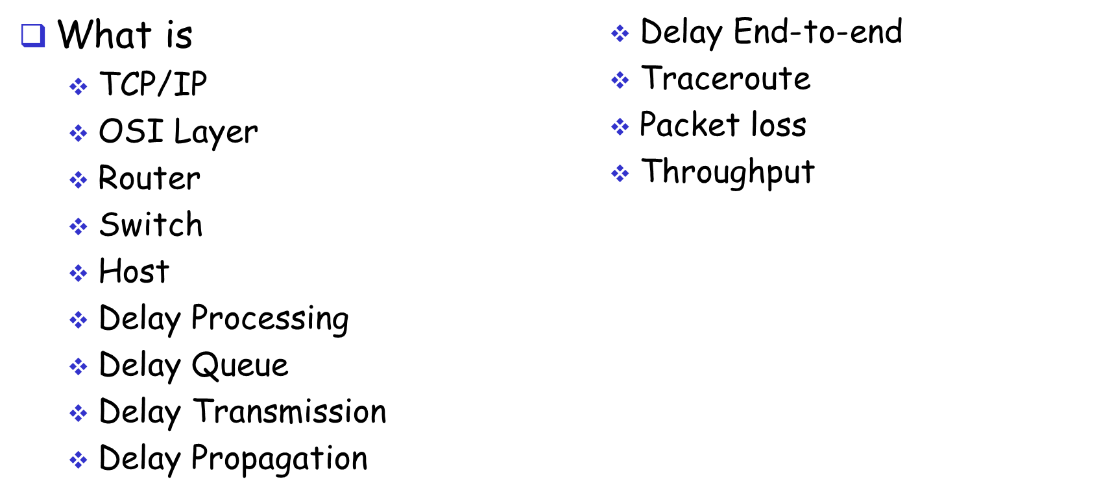
Review

Slide 22
Exercises

Slide 23
Q01 – Propagation Delay
How long does it take a packet of length 1,000 bytes to propagate over a link of distance 5,000 km, propagation speed 2.5x10⁸ m/s and transmission rate 1 Mbps? Generally, how long does it take a packet of length L to propagate over a link of distance d, propagation speed s, and transmission rate R bps? Does this delay depend on packet length? Does this delay depend on transmission rate?
Notes:
Transmission delay = L/R
= 8 bits/byte * 1,000 bytes / 1,000,000 bps
= 8 ms
Propagation delay = d/s
= 2,500 / 2.5×10^5
= 10 ms
Therefore, the total time = 8ms + 10 ms = 18 ms
No, the delay depend on packet lenght is not true.
No, the delay depend on transmission rate is not true.

Slide 24
Q02 - Transmission delay
How long does it take to transmit a packet of length 1,000 bytes a link of distance 5,000 km, propagation speed 2.5x10⁸ m/s and transmission rate 1 Mbps? Generally, how long does it take to transmit a packet of length L over a link of distance d, propagation speed s, and transmission rate R bps? Does this delay depend on the length of the link? Does this delay depend on the propagation speed of the link?
Notes:
(5000*10^3)/(2.5*10^8)=0.02s = 20ms
d/s, distance / propagation speed
Does this delay depend on the length of the link? Yes
Does this delay depend on the propagation speed of the link? Yes
Dose this delay depend on packet length? No (4)
Does this delay depend on transmission rate? No

Slide 25
Q02 - Transmission delay and propagation delay
Consider two packet switches directly connected by a link of 5000 km, propagation speed 2.5x10⁸m/s and transmission rate 1 Mbps. How long does it take to move a packet of length 1,000 bytes from one packet switch to the other packet switch? Generally, how long does it take to move a packet of length L over a link of distance d, propagation speed s, and transmission rate R bps?
Notes:
d/s = 5000 km = 5*10^6
S = 2.5*10^8
5*10^6 / 2.5*10^8 = 2 *10^-2s = 20 ms
L/R
1000 bytes /R

Slide 26
Q02 - Delays with multiple links
Consider a packet of length L which begins at end system A, travels over one link to a packet switch, and travels from the packet switch over a second link to a destination end system B. Let d_{i}, s_{i} and R_{i} denote the length, propagation speed, and transmission rate of link i, for i = 1, 2. The packet switch delays each packet by d_{proc}. Assuming no queuing delays, in terms of d_{i}, s_{i} , R_{i}, (i=1,2) and L, what is the total end-to-end delay for the packet? Suppose the packet is 1,000 bytes, the propagation speed on both links is 2.5x10⁸ m/s, the transmission rates of both links is 1 Mbps, the packet switch processing delay is 1 msec, the length of the first link is 4,000 km, and the length of the last link is 1,000 km. For these values, what is the end-to-end delay?
Notes:
L1/R1 + L2/R2 + d1/s1 + d2/s2 + dproc
LI/R1 = 1000 *8 / 1*10^6 = 0.008 s = 8 ms
L2/R2 = 1000 *8 / 1*10^6 = 0.008 s = 8 ms
d1/s1 = 4000 *10^3 /2.5*10^8 = 4*10^6 / 2.5*10^8 = 1.6 *10^-2 = 0.016 s = 16 ms
d2/s2 = 1000 *10^3 /2.5*10^8 = 1*10^6 / 2.5*10^8 = 0.4 *10^-2 = 0.004 s = 4 ms
Dproc = 1ms
End to end delay = 8ms + 8ms +16ms +4ms +1 ms = 37 ms
Server – link1-link2(client)

Slide 27
Q03 - Queuing delay
A packet switch receives a packet and determines the outbound link to which the packet should be forwarded. At packet arrival, one other packet is half transmitted on this outbound link and three other packets are waiting to be transmitted. Packets are transmitted in order of arrival. Suppose all packets are 1,000 bytes and the link rate is 1 Mbps. What is the queuing delay for the packet? Generally, what is the queuing delay when all packets have length L bits, the transmission rate is R, x bits of the currently transmitted packet have been transmitted, and N packets are already in the queue?
Notes:
L = Packet Length = 1000 bytes = 8000 bit
R = Transmission Rate = 1 Mbps
X bits = current transmitted packet = 500 bytes =4000 bit
N=waiting queue = 4
Queuing delay=(nL+(L-x))/R
=(4*8000)+(8000 – 4000)/(2*10^6)
=36*10^3/(1*10^6)
=36 *10^-3 s
=0.036 seconds
2400 bytes * 8 = 19200
2Mbps
= 4*19200 + 9600 / 2*10*6
(76800 + 9600) / 2*10^6
86.4*10*3 / 2*10^6
43.2 x 10^-3 = 43 msec

